Slide 1


Machine Learning
Hichri Hafedh

Slide 2

What is machine learning
01
I DONNO MAN SOUNDS INTERISTING !

Slide 3
the use and development of computer systems that are able to learn and adapt without following explicit instructions, by using algorithms and statistical models to analyse and draw inferences from patterns in data.

Slide 4
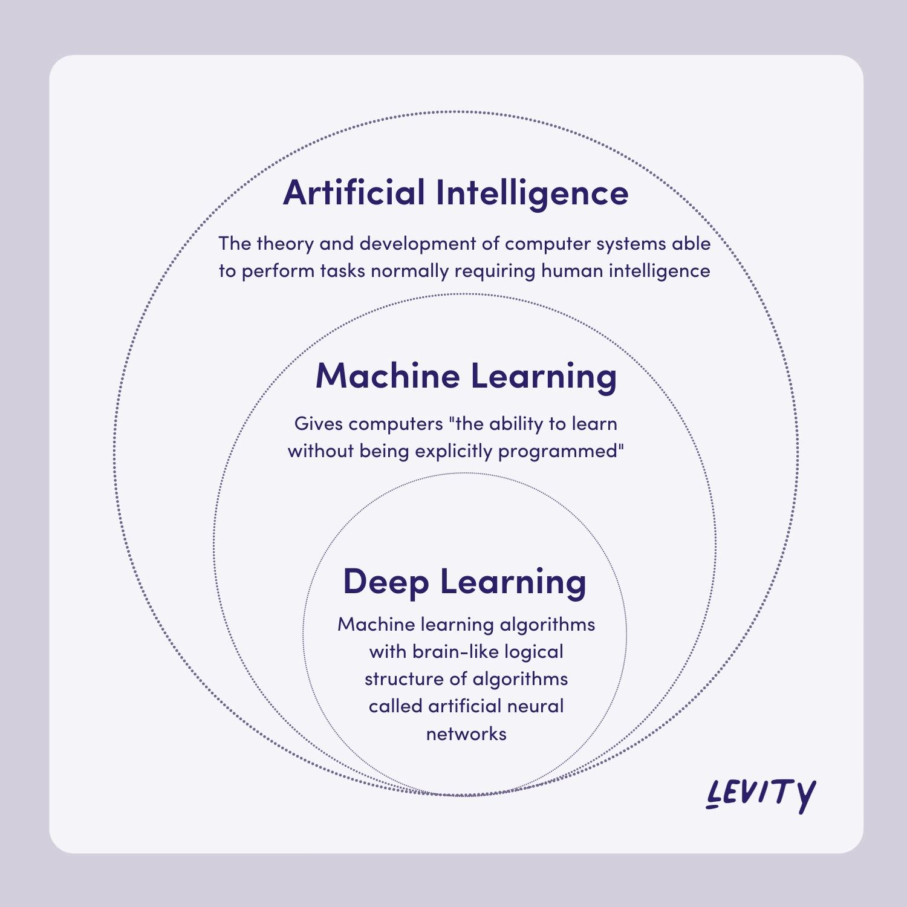

Slide 5


Slide 6


Slide 7
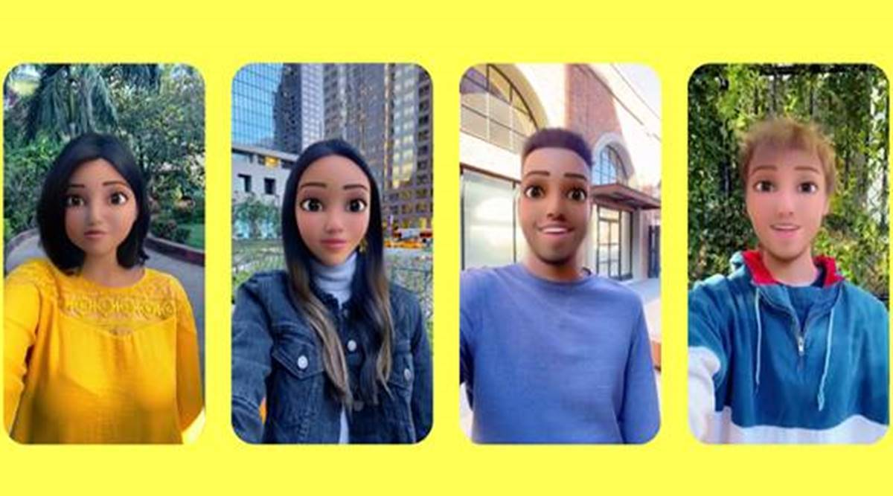

Slide 8


Slide 9


Slide 10
Types of machine learning
02
WHAT ARE THEY !!

Slide 11
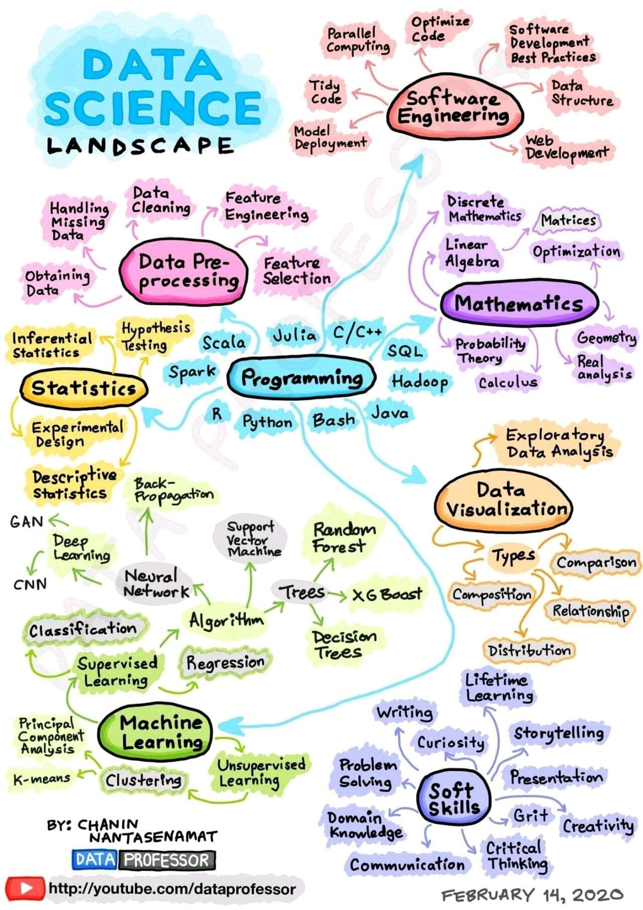

Slide 12


Slide 13
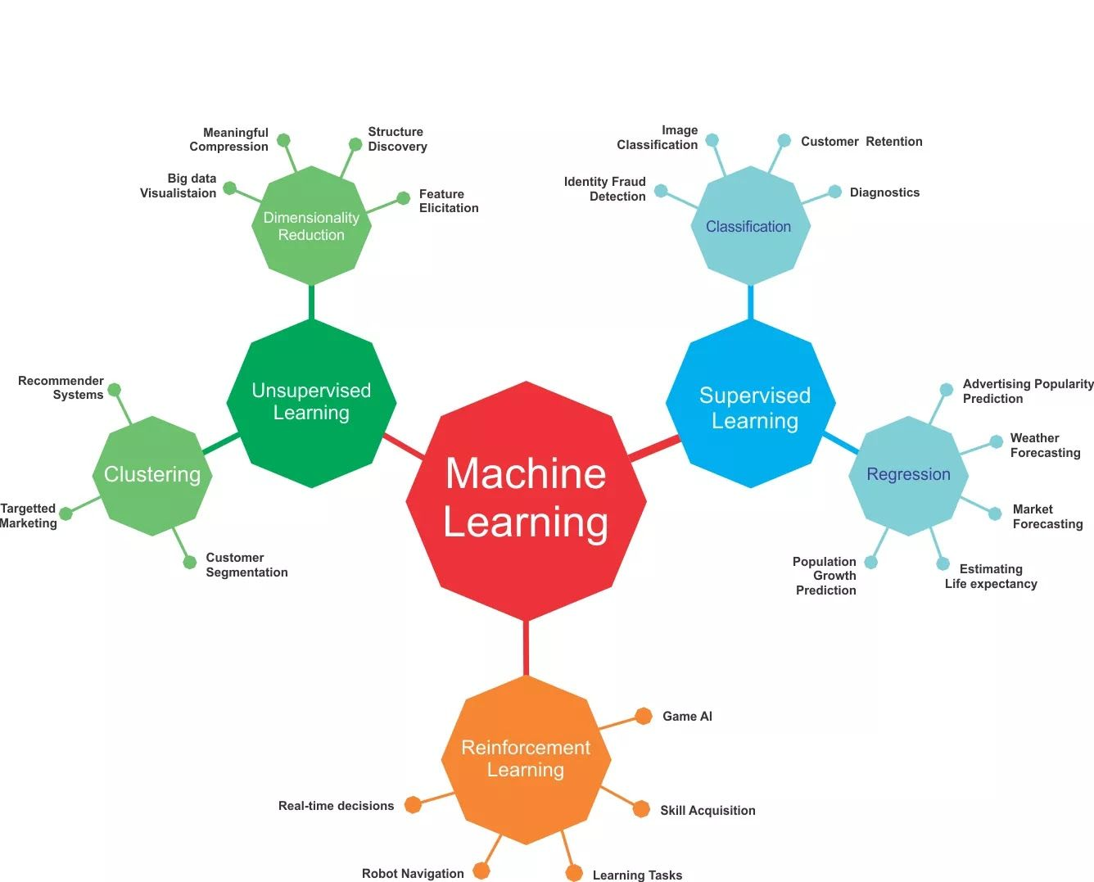

Slide 14
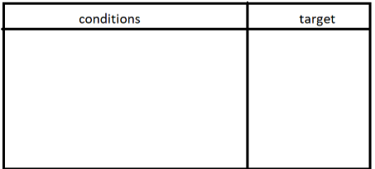
Supervised Learning
- supervised learning treats labeled data - it can also be identified when the data base contains a target column in which the AI model needs to identify it's content , example : when the AI model receives health tests of a patient it needs to identify whether the patient is suffering from a heart disease

Slide 15
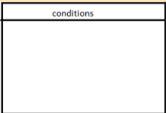
Unsupervised Learning
-when the AI model receives a certain data base it sees a certain pattern pattern and it groups the data in a groups also called clusters -unlike the supervised learning , here the data base does not contain a target column example : when given a certain data base of the purchases of customers we group them into 2 , 3 or 4 groups

Slide 16
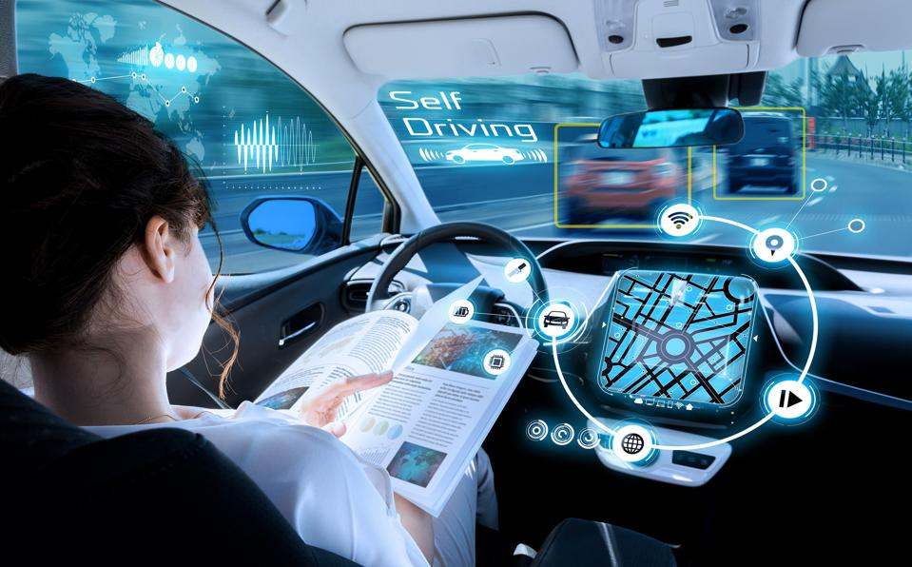
Reinforcement Learning
-unlike the previous learning methods reinforcement learning creates an agent also called a bot in a virtual environment and lets it learn by interacting with the environment around it -example : a bot in a game , a chess bot , auto-driving car algorithms

Slide 17
pipeline
03
WHERE DO I START !!!

Slide 18
Steps:
1- Import data
2- Data preprocessing
3- Splitting data(train / test)
4- Model creation
5- Train model
6- Test model
7- Using the model

Slide 19


Thanks for your attention

